Slide 1

Modeling Basics
Modeling Basics
The start-to-finish of Bayesian Cognitive Modeling
Saee Paliwal
TNU CPC
August, 2016

Slide 2
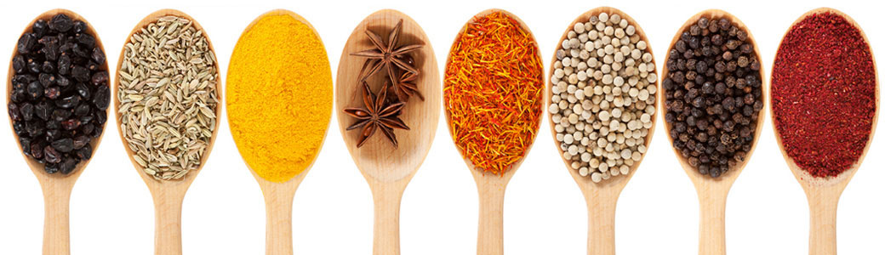
The Basics
who
All cognitive agents model (insects, animals, humans)
what
Learning from data to understand and make predictions about one’s surroundings.
where
Everywhere, even where there’s no data (i.e. sensory deprivation chambers)!
when
All day, every day.
why
The ability to understand and predict our environments ensures our survival.
how
Frequentists vs Bayesian

Slide 3
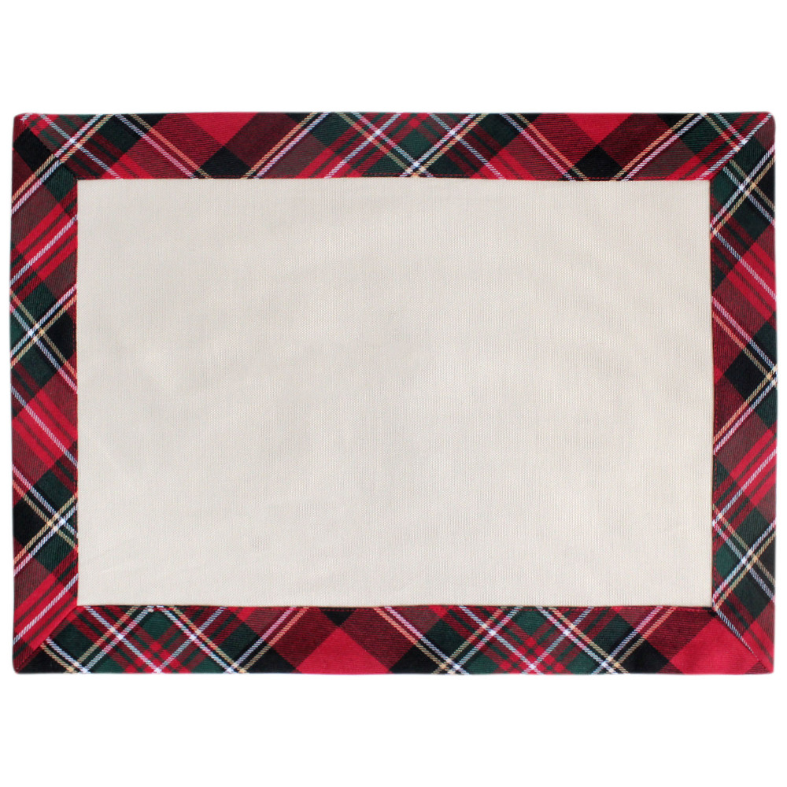
Hamish’s Scottish Taverne Menu
Frequentist approach
Haggis
Haggis deluxe
Haggis supreme
Haggis a la mode
Haggis au gratin
Chicken Tikka Masala
Haggis flambée
Haggis surprise
Make-your-own Haggis
Something else involving Haggis
Allows us to characterize the likelihood of an event given the data alone (i.e. how frequently does an event occur)
Likelihood ratio, non-Haggis to Haggis:
1:10

Slide 4
Bayes Theorem
We use parameters θ from proposed model M to model data y.
Prior: P(θ|M)
Likelihood: P(y|θ, M)
Posterior: P(θ|y, M)
Model Evidence: P(y|M)
Full equality:
Posterior = Likelihood * Prior
Model Evidence
P(θ|y,M) = P(y|θ,M)P(θ|M)
Σ_{θ’}P(y|θ’, M) P(θ’|M)
P(θ|y,M) Σ_{θ’} P(y|θ’, M) P(θ’|M)

Slide 5
The prior
What information do we have before we see any data?
Prior odds ratio 75: 15

Slide 6
Applying Bayes Theorem
Prior odds ratio 75: 15
Likelihood ratio 1: 10
Posterior odds ratio 75: 150 → 1:2
So there’s a 50% chance that you think you’re not eating sheep stomach. Success.

Slide 7
Our goal
Inferring generative models from observed data.
Notes:
We’re constantly seeing data. This is the Bayesian brain Hypothesis. We want to model the world around us. Our brain is doing the same thing.

Slide 8

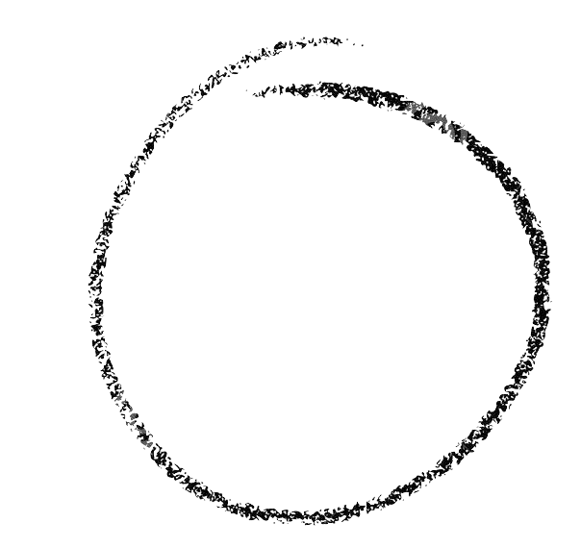

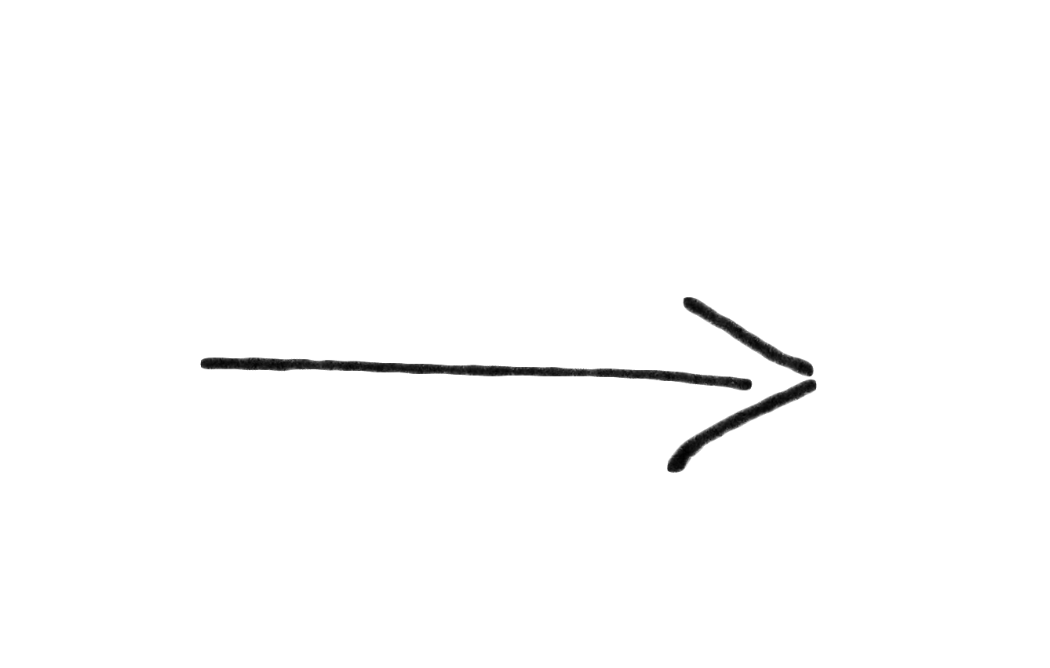
Prep Time:
Longer than you think
Cook Time:
1 PhD duration, or until funding runs out
Plating/serving:
Serve with journal of your choice
Recipe:
Bayesian Cognitive Model
Ingredients:
1. 1 Question or Interest Area
2. 1 well-formed Hypothesis
3. 1 medium-sized Task
4. 2 ripe Models
5. 1 heaping Tbsp Simulations
6. 9”x12” Inversion Technique
7. 2 cups Data
8. Model selection

Slide 9

Our problem: The Tricky Coin

Slide 10

Step 1: Question
Friend tosses a tricky coin. What is the probability of heads?

Slide 11
Step 2: Hypothesis
3 competing hypotheses:
We have no information about the coin = Uniform prior
We believe the coin to be fair = tight prior around 0.5
We have a suspicion that the coin is unfair = weak prior around 0.3
Prior 1 Prior 2 Prior 3

Slide 12
Step 3: Task - Coin toss
Our task is to flip a coin 100 times and observe the probability of heads.
Say we observe 65 successes (heads).

Slide 13
Step 4: Model
Beta-binomial model
Prior: Beta distribution
Likelihood: Binomial distribution
For 65 successes, our likelihood looks as follows:

Slide 14
Step 5: Simulations
Simulations
Hypothesis 1:
Simulations
Hypothesis 2:
Simulations
Hypothesis 3:
Notes:
Why and how do we do simulations. Create a LARGE set of data, why do you do this, can you recover the parameters, are they correlated. How small a set of data can you get to still get a reasonable result. Can you separate the model families. Fminsearch, gradient descent, then sampling and VB

Slide 15
Step 6: Model Inversion
Different types of model inversion:
sampling methods (Markov-chain Monte Carlo) versus Variational methods (Variational Bayes)
MCMC:
Mechanism: sample from a proposal distribution and generate a set of plausible samples from the posterior
Advantages: more precise
Drawbacks: computationally intensive (often takes a long time)
Variational Bayes:
Mechanism: Analytic inversion of a model under the mean field approximation
Advantages: extremely fast
Drawbacks: often inexact

Slide 16
Step 7: Data
Say we now play the task. We observe a set number of heads, say 32 heads out of 100 tosses. We now want to asses which of our compoeting hypotheses (i.e. our 3 priors) is most plausible. In order to do so, we invert our Beta-Binomial model on the observed data:
Inversion results:

Slide 17
Step 7: Model selection
How do we know which model is ideal?
Objective function: Free energy
Expected
Log-joint
(Accuracy)
Entropy
(Complexity)

Slide 18
Step 8: Model selection
How do we know which model is ideal?
Objective function: Free energy
Expected
Log-joint
(Accuracy)
Entropy
(Complexity)

Slide 19

Thank you!

Slide 20
Questions?

